Slide 1

ADDRESSING DOMESTIC VIOLENCE IN INDIA
A DATA-DRIVEN, POLICY-ORIENTED, AND TECHNOLOGICAL APPROACH
Submitted for: Summer Projects ’25
Prepared by:
Suraj Kumar Yadav yadavsurajkumar665@gmail.com
Omkar Mahanandia omkarmahanandia@gmail.com
Bharti Gangwar bhartigangwar9389@gmail.com

Slide 2


"The measure of any society is how it treats its women and girls. And when they are being demeaned, disrespected, and violated, it reflects a deep moral failing in that society."
— Michelle Obama

Slide 3

Domestic violence in India remains a widespread and significantly underreported violation of human rights. While over 30% of Indian women aged 15–49 have disclosed experiencing abuse, this statistic represents only the visible portion of a much deeper crisis. Domestic violence cuts across gender and age lines, impacting men, transgender individuals, children, and the elderly alike.
This report presents a comprehensive roadmap, integrating national data analysis, stakeholder perspectives, international best practices, and advancements in technology. Key insights underscore the urgent need for legal reform, enhanced implementation mechanisms, survivor-focused technological solutions, and inclusive, community-driven awareness initiatives. The recommendations provided are scalable, adaptable, and sensitive to the diverse socio-cultural fabric of India.

Slide 4
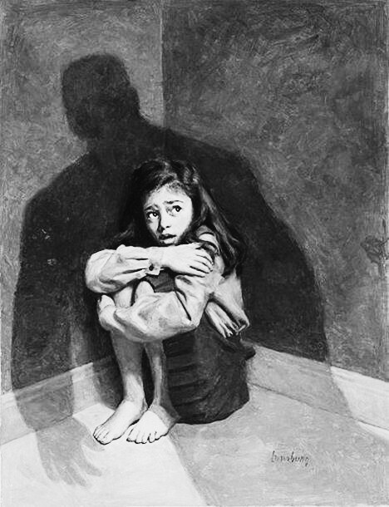
Introduction
Objectives of the Study
Methodology
Scale of the Problem
Demographic Breakdown
Patterns and Recurrence
Causes and Triggers
Current Laws and Protection Mechanisms
Legal Gaps and Challenges
Support Infrastructure
Stakeholder Analysis
Awareness and Community Engagement
Technology-Driven Innovations
International Case Studies
Recommendations – Policy Level
Recommendations – Tech and Infra
Implementation Plan
Sustainability and Funding
Conclusion
References
Appendices
TABLE OF CONTENTS

Slide 5

INTRODUCTION
Introduction Domestic violence is one of the gravest yet underrecognized crises in India. Defined as any form of abuse within intimate or familial relationships, it encompasses physical, emotional, psychological, sexual, and economic harm. While women are statistically the most impacted, it is critical to note that men, LGBTQ+ individuals, the elderly, and children are also susceptible to domestic abuse. This report seeks to analyze and address this multifaceted issue through an intersectional and inclusive lens.

Slide 6


OBJECTIVES OF THE STUDY
The objective of this study is to conduct a comprehensive examination of harassment and domestic violence against women in India, focusing on its prevalence, patterns, and root causes. The study aims to analyze the socio-cultural, economic, legal, and psychological factors that contribute to the persistence of gender-based violence.
It further seeks to assess the effectiveness of existing legal and policy frameworks, institutional responses, and support systems available to survivors. By incorporating multi-stakeholder perspectives—including those of survivors, legal professionals, law enforcement, healthcare providers, and civil society organizations—the study endeavors to provide a nuanced understanding of the issue. Additionally, it explores the role of emerging technologies in enhancing prevention, reporting, and survivor support mechanisms.
The findings aim to inform the development of evidence-based, scalable, and contextually relevant strategies that promote accountability, strengthen institutional capacity, and foster a culture of zero tolerance toward violence and harassment against women.

Slide 7


Data Sources:
The study is grounded in data from reputable and authoritative institutions, including the National Commission for Women (NCW), the World Health Organization (WHO), and the Institute for Human Development (IHD). These sources provide both quantitative metrics and qualitative insights essential for understanding the multi-layered dimensions of harassment and domestic violence.
Tools Utilized:
Data processing and analysis were conducted using Python for cleaning and statistical modeling. Tableau and Power BI were leveraged to develop interactive visual dashboards, while Canva and Figma supported the creation of user-friendly prototypes and communication materials.
Analytical Approach:
The study adopted a mixed-methods approach comprising descriptive statistics to capture key trends, comparative analysis to evaluate variations across regions and demographics, and GIS mapping to visualize spatial patterns of reported incidents. Additionally, stakeholder mapping was employed to identify critical actors, institutional gaps, and potential collaboration pathways within the response ecosystem.
METHODOLOGY

Slide 8
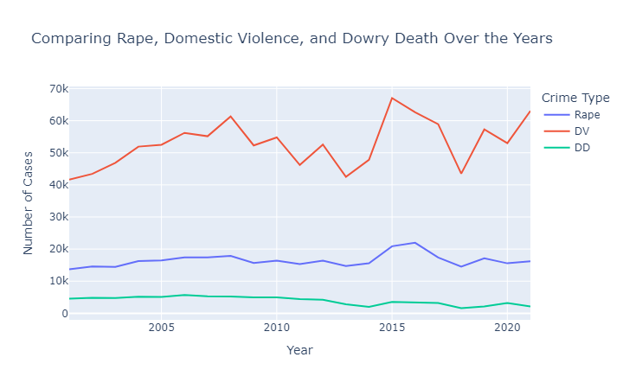
SCALE OF THE PROBLEM
According to NFHS-5 data, approximately one in three women in India has experienced some form of domestic violence—whether physical, emotional, or sexual. However, this alarming statistic likely represents only the surface of a much deeper issue. Underreporting remains widespread, driven by factors such as fear of retaliation, deeply ingrained cultural norms, societal stigma, and the absence of accessible support systems. Furthermore, inconsistencies in data collection, coupled with delays in justice delivery, make it difficult to accurately assess the full scale and evolving nature of the problem. These challenges collectively hinder policy formulation, resource allocation, and long-term interventions needed to address domestic violence in a sustained and systemic manner.

Slide 9
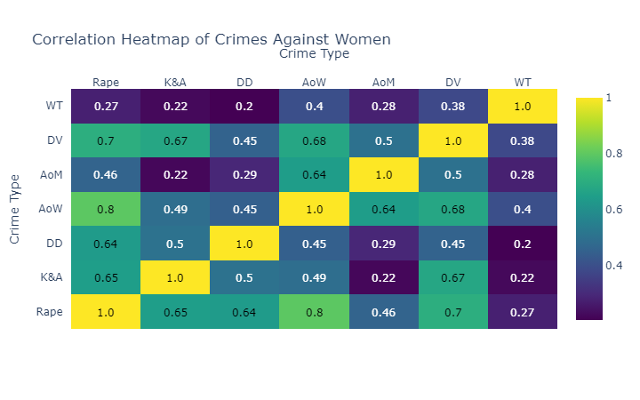
Correlation Heatmap of Crimes against women

Slide 10
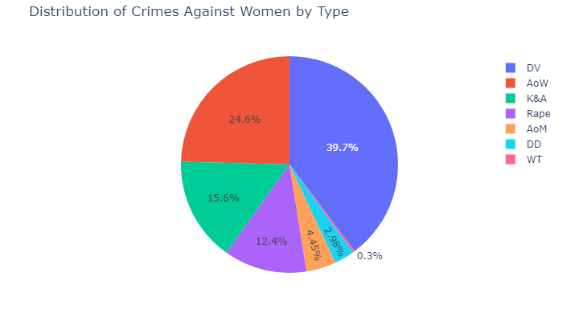
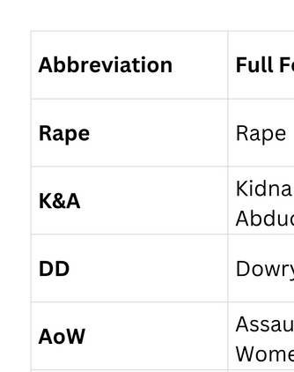

Slide 11
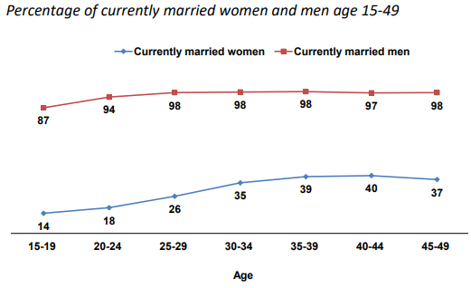
DEMOGRAPHIC BREAKDOWN
The study categorizes domestic violence data by age, marital status, caste, income, education, and gender to understand patterns across social groups. While women form the majority of reported cases, male and LGBTQ+ victims remain critically underreported, largely due to stigma, societal bias, and lack of institutional support. This highlights the importance of adopting inclusive and intersectional approaches in both policy and response mechanisms.
EMPLOYEEMENT BY AGE

Slide 12
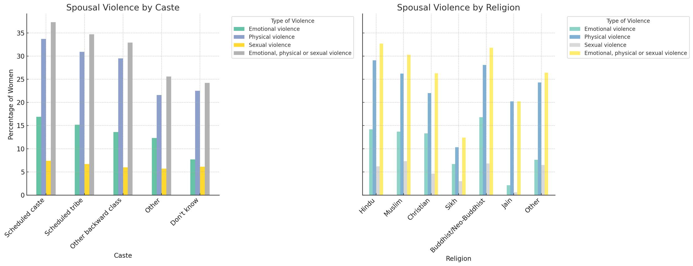
Spousal Violence by Caste and Religion

Slide 13
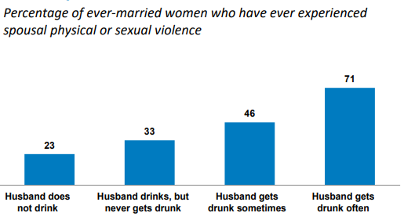
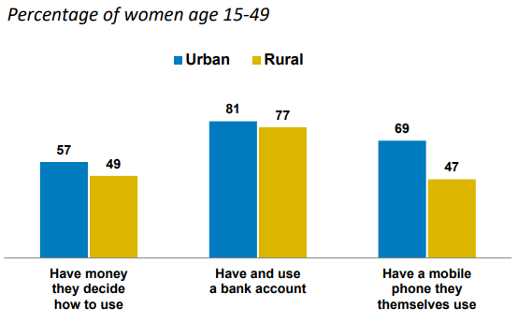
SPOUSAL VIOLENCE BY HUSBAND ALCOHOL CONSUMPTION
OWNERSHIP OF FINANCIAL ASSETS AND MOBILE PHONE

Slide 14
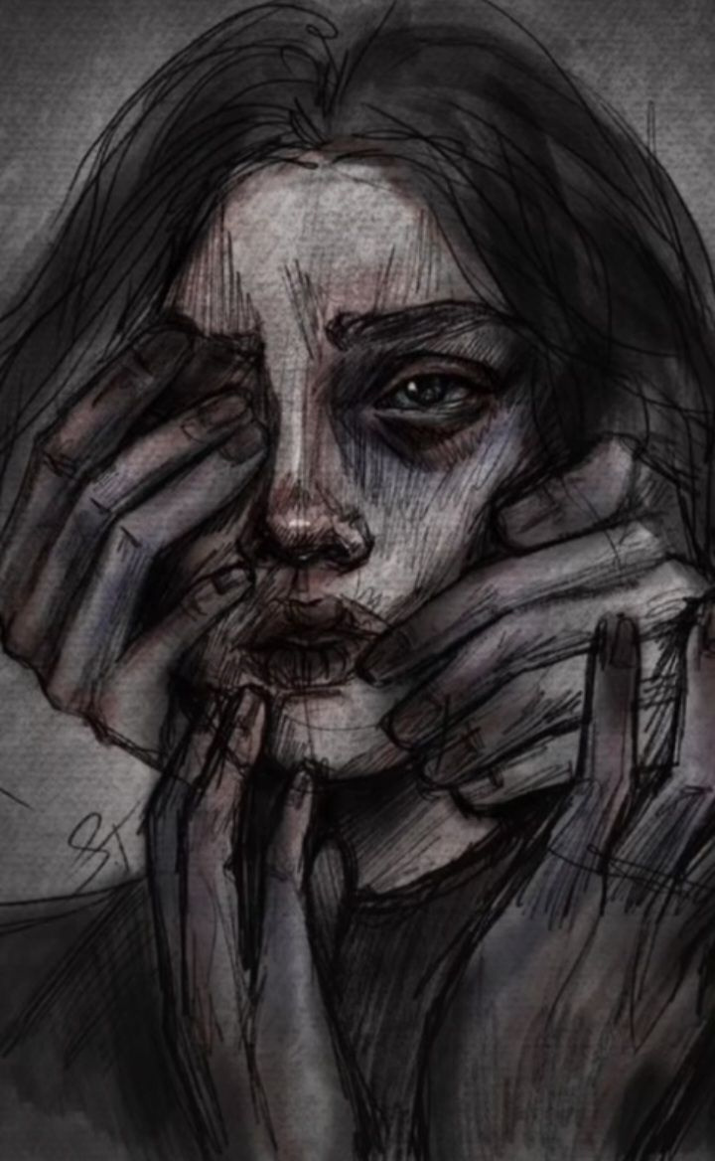
PATTERNS AND RECURRENCE
DOMESTIC VIOLENCE FREQUENTLY FOLLOWS A REPETITIVE CYCLE CONSISTING OF TENSION-BUILDING, THE ABUSIVE INCIDENT, FOLLOWED BY RECONCILIATION, AND A TEMPORARY PHASE OF CALM. THIS PATTERN, KNOWN AS THE CYCLE OF ABUSE, IS COMMON AMONG REPEAT VICTIMS—MANY OF WHOM REMAIN IN THESE HARMFUL SITUATIONS DUE TO FEAR, SOCIAL PRESSURE, OR ECONOMIC DEPENDENCE. THE RECURRENCE IS PARTICULARLY EVIDENT IN LONG-TERM MARRIAGES AND LOW-INCOME HOUSEHOLDS, WHERE ABUSE IS OFTEN NORMALIZED OR HIDDEN. UNDERSTANDING THIS CYCLE IS CRUCIAL FOR DESIGNING EARLY INTERVENTION STRATEGIES AND SUPPORT SYSTEMS.

Slide 15
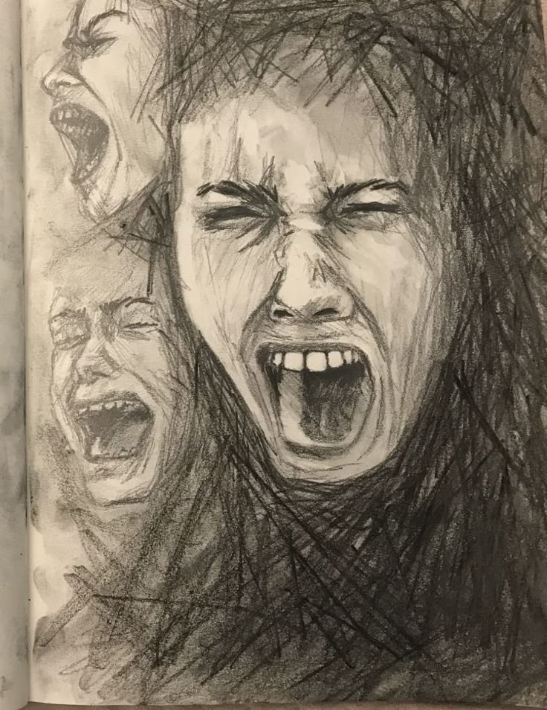
COMMON CYCLES OF ABUSE
THE CYCLE OF ABUSE—COMPRISING TENSION-BUILDING, INCIDENT, RECONCILIATION, AND CALM—IS A WELL-RECOGNIZED MODEL ACROSS CULTURES .
IN INDIA, LOCALIZED QUALITATIVE STUDIES AND REPORTS (E.G., FROM NGOS AND DOMESTIC VIOLENCE RESEARCH) CONFIRM THE PRESENCE OF ALL FOUR PHASES, OFTEN WITH ESCALATING INTENSITY AND SHORTER CALM INTERVALS OVER TIME .
ONE BROADER INDIAN SURVEY SUGGESTS THAT OVER 60–70% OF VICTIMS ARE REPEAT SURVIVORS, UNDERSCORING PERSISTENT CYCLES OF ABUSE .

Slide 16

NORMALIZATION IN MARRIAGES & LOW-INCOME HOUSEHOLDS
DOMESTIC VIOLENCE IS OFTEN NORMALIZED IN LONG-TERM MARRIAGES AND ECONOMICALLY VULNERABLE HOUSEHOLDS DUE TO CULTURAL CONDITIONING, LACK OF AWARENESS, AND FINANCIAL DEPENDENCE.
In an urban slum study (Telangana), 70.5% of married women reported experiencing domestic violence.
Among these, 67% faced repeated physical abuse, highlighting long-term normalization.
A rural South India study found that 34% of women faced frequent abuse, with emotional and physical violence being most common.
According to NFHS-5, women in the lowest wealth quintile experience abuse at nearly double the rate (39%) compared to those in the highest quintile (17%).
Alcohol use by male partners is a significant contributing factor in many low-income households.
Fear of social stigma, limited legal awareness, and lack of shelter or income sources discourage women from seeking help or reporting abuse.

Slide 17

PATRIARCHY AND TOXIC MASCULINITY
DEEP-ROOTED GENDER INEQUALITY NORMALIZES MALE DOMINANCE.
SOCIETAL EXPECTATIONS PRESSURE MEN TO CONTROL, NOT EXPRESS EMOTION.
STAT: 70% OF INDIAN WOMEN BELIEVE DOMESTIC VIOLENCE CAN BE JUSTIFIED IN SOME CASES (NFHS-5, 2021).
MASCULINITY OFTEN TIED TO AGGRESSION AND CONTROL.

Slide 18

ALCOHOL AND SUBSTANCE ABUSE
IMPAIRS DECISION-MAKING AND INCREASES AGGRESSION.
Used as a common trigger in violent incidents.
Stat: 33% of domestic violence cases involved an intoxicated partner (National Crime Records Bureau - NCRB, 2022).
Alcohol use often coexists with controlling behaviors.

Slide 19
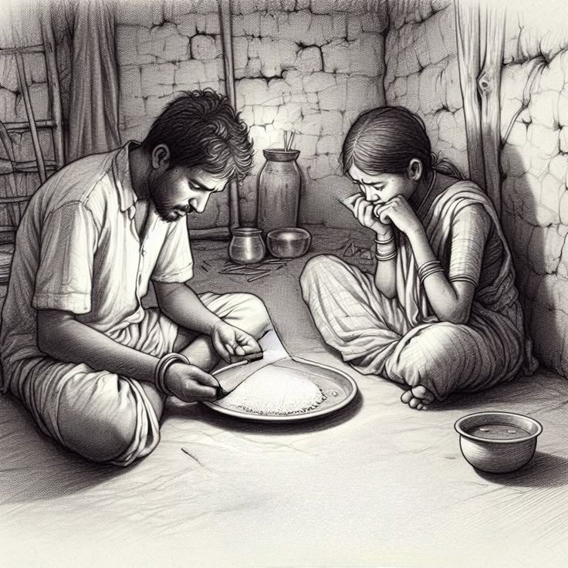
FINANCIAL INSTABILITY
JOB LOSS, DEBT, OR POVERTY INCREASES HOUSEHOLD STRESS.
Women may tolerate abuse due to financial dependency.
Stat: Households with income under ₹10,000/month reported 2x more DV incidents (UN Women India Report, 2023).
Economic vulnerability reduces escape options.

Slide 20
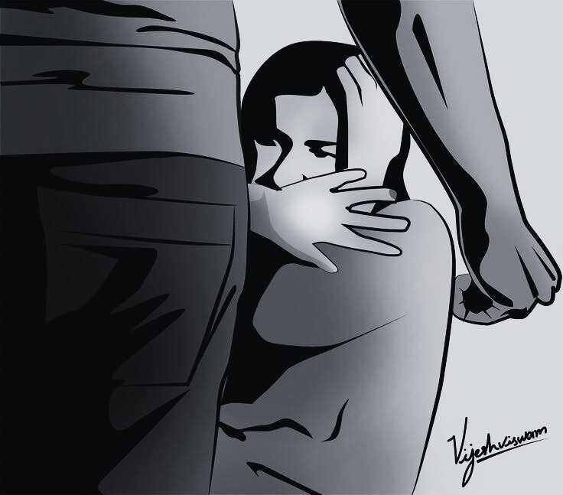
CULTURAL JUSTIFICATION & NORMALIZATION
ABUSE TREATED AS A “PRIVATE FAMILY MATTER.”
Shame and stigma discourage reporting.
Religious/moral justifications silence survivors.
Stat: 86% of women who experience domestic violence do not seek help (NFHS-5, 2021).
Fear of social exclusion deters victims.

Slide 21

PROTECTION OF WOMEN FROM DOMESTIC VIOLENCE ACT (PWDVA), 2005
CIVIL LAW FOCUSED ON PROTECTION RATHER THAN PUNISHMENT.
Grants:
Right to reside in shared household.
Protection orders against abuser.
Maintenance and compensation for injuries.
Custody orders for children.
Covers physical, emotional, sexual, verbal, and economic abuse.
Applicable to married women, live-in relationships, and family members.

Slide 22
SECTION 498A OF THE INDIAN PENAL CODE (IPC)
CRIMINAL PROVISION ENACTED IN 1983.
Addresses cruelty by husband or in-laws.
Cruelty includes:
Physical or mental harassment.
Demands for dowry.
Punishable with imprisonment up to 3 years and fine.
Cognizable and non-bailable offense.

Slide 23
DOWRY PROHIBITION ACT, 1961
Penalizes giving, taking, or demanding dowry.
Punishment: up to 5 years imprisonment + ₹15,000 fine or value of dowry (whichever is higher).
Sexual Harassment of Women at Workplace (Prevention, Prohibition and Redressal) Act, 2013
Protects working women from sexual harassment at work.
Employers must establish Internal Complaints Committees (ICCs) at workplaces.
Indian Evidence Act, 1872 – Section 113B
Presumes dowry death if a woman dies unnaturally within 7 years of marriage + evidence of cruelty/dowry demands.
Section 304B IPC – Dowry Death
Deals with death of a woman due to burns, injury, or other unnatural circumstances within 7 years of marriage, linked to dowry demands.
Punishable with 7 years to life imprisonment.
Section 125 CrPC – Maintenance
Provides right for wife, children, and parents to claim maintenance from a man who neglects them.

Slide 24
LEGAL GAPS AND IMPLEMENTATION CHALLENGES :-
LACK OF AWARENESS AND LOW LEGAL LITERACY
MANY CITIZENS, ESPECIALLY IN RURAL AREAS, ARE UNAWARE OF THEIR LEGAL RIGHTS DUE TO LIMITED LEGAL EDUCATION.
INADEQUATE OUTREACH AND EDUCATION ON NEW LAWS, SUCH AS THE BHARATIYA SAKSHYA ADHINIYAM (BSA), HINDER EFFECTIVE IMPLEMENTATION.
COURT BACKLOGS AND DELAYS IN PROTECTION ORDERS
OVER 4 MILLION CASES PENDING IN HIGH COURTS AND 29 MILLION IN TRIAL COURTS, EXACERBATED BY OUTDATED PROCEDURAL LAWS.
DELAYS IN ISSUING PROTECTION ORDERS IMPACT TIMELY JUSTICE, PARTICULARLY FOR VULNERABLE GROUPS.
SURVIVOR CHALLENGES
STIGMA: SURVIVORS FACE SOCIAL STIGMA, DETERRING THEM FROM SEEKING JUSTICE.
ECONOMIC COERCION: FINANCIAL DEPENDENCE OR PRESSURE LIMITS ACCESS TO LEGAL RECOURSE.
PROCEDURAL ROADBLOCKS: COMPLEX LEGAL JARGON, LANGUAGE BARRIERS, AND INACCESSIBLE COURT INFRASTRUCTURE (E.G., NON-DISABLED-FRIENDLY COURTS) EXCLUDE MARGINALIZED GROUPS.

Slide 25
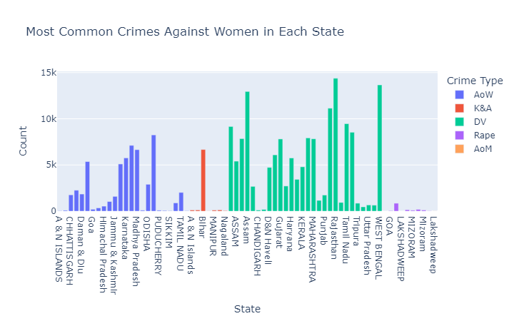

Slide 26
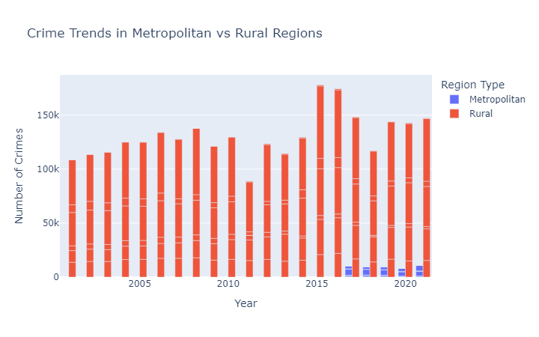

Slide 27
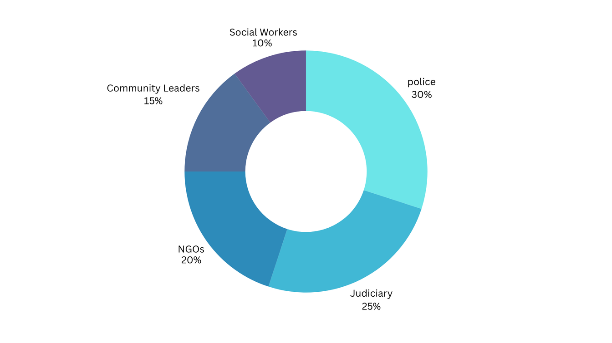
KEY ACTORS AND GAPS IN SUPPORT SYSTEMS
POLICE: FIRST RESPONDERS FOR COMPLAINTS; MANAGE WOMEN’S HELPDESKS AND ENFORCE PROTECTION ORDERS.
JUDICIARY: ADJUDICATES CASES, ISSUES PROTECTION ORDERS, AND OVERSEES LEGAL AID UNDER THE LEGAL SERVICES AUTHORITIES ACT, 1987.
NGOS: PROVIDE SHELTERS, LEGAL AID, AND AWARENESS CAMPAIGNS; BRIDGE GAPS IN RURAL AREAS (E.G., SEWA, ACTIONAID).
COMMUNITY LEADERS: INFLUENCE LOCAL NORMS, MEDIATE DISPUTES, AND PROMOTE AWARENESS IN RURAL AND TRIBAL AREAS.
SOCIAL WORKERS: OFFER COUNSELING, CASE MANAGEMENT, AND SUPPORT AT ONE STOP CENTRES (OSCS) AND SHELTERS.

Slide 28
GAPS IN COMMUNICATION AND ACCOUNTABILITY
COMMUNICATION GAPS:
POOR COORDINATION BETWEEN POLICE AND JUDICIARY DELAYS CASE PROGRESSION
(E.G., SLOW FIR-TO-TRIAL TRANSITIONS).
NGOS AND COMMUNITY LEADERS OFTEN EXCLUDED FROM POLICY PLANNING, LIMITING GRASSROOTS FEEDBACK.
INCONSISTENT DATA SHARING BETWEEN OSCS, LEGAL AID CLINICS, AND POLICE HINDERS CASE TRACKING.
ACCOUNTABILITY GAPS:
POLICE: LIMITED GENDER SENSITIVITY TRAINING; DELAYS IN INVESTIGATIONS OFTEN GO UNMONITORED.
JUDICIARY: OVER 29 MILLION PENDING CASES IN TRIAL COURTS SLOW DOWN JUSTICE DELIVERY.
NGOS: LACK OF FUNDING AND STANDARDIZED REPORTING REDUCES MEASURABLE IMPACT.
COMMUNITY LEADERS/SOCIAL WORKERS: LIMITED RESOURCES AND AUTHORITY TO DRIVE SYSTEMIC CHANGE.

Slide 29
AWARENESS AND COMMUNITY ENGAGEMENT FOR WOMEN’S SAFETY
MEN AND BOYS AS ALLIES
ENGAGE MEN AND BOYS AS ADVOCATES TO CHALLENGE GENDER NORMS AND PREVENT VIOLENCE.
PROGRAMS LIKE "MENENGAGE" OR WORKSHOPS IN COMMUNITIES TO PROMOTE ALLYSHIP.
EXAMPLE: CAMPAIGNS ENCOURAGING MEN TO SUPPORT SURVIVORS AND ADVOCATE FOR EQUALITY.
AWARENESS IN SCHOOLS, WORKPLACES, AND LOCAL GOVERNANCE
SCHOOLS: INTEGRATE GENDER SENSITIVITY INTO CURRICULA; CONDUCT WORKSHOPS FOR STUDENTS AND TEACHERS.
WORKPLACES: MANDATORY TRAINING ON HARASSMENT LAWS (E.G., POSH ACT, 2013); CREATE SAFE REPORTING MECHANISMS.
LOCAL GOVERNANCE: TRAIN PANCHAYATI RAJ INSTITUTIONS (PRIS) TO ADDRESS GENDER-BASED VIOLENCE AND PROMOTE WOMEN’S RIGHTS.REGIONAL CUSTOMIZATIONS FOR LANGUAGE AND OUTREACH
REGIONAL CUSTOMIZATIONS FOR LANGUAGE AND OUTREACH
TAILOR CAMPAIGNS TO LOCAL LANGUAGES (E.G., HINDI, TAMIL, BENGALI) AND CULTURAL CONTEXTS.
USE REGIONAL MEDIA (E.G., RADIO IN RURAL AREAS, SOCIAL MEDIA IN URBAN CENTERS) FOR BROADER REACH.
EXAMPLE: IN UTTAR PRADESH, USE BHOJPURI FOLK SONGS FOR RURAL OUTREACH; IN KARNATAKA, LEVERAGE KANNADA TV CHANNELS.

Slide 30



Slide 31



TECHNOLOGY-DRIVEN INNOVATIONS FOR WOMEN’S SAFETY
TECH SOLUTIONS FOR EMPOWERMENT
SOS APPS: GPS-ENABLED ALERTS, VOICE COMMANDS, DISGUISE MODES (E.G., SAFETIPIN, 112 INDIA).
AI PREDICTIVE TOOLS: FLAG HIGH-RISK HOUSEHOLDS USING CRIME AND SOCIO-ECONOMIC DATA.
CHATBOTS: MULTILINGUAL LEGAL AID, MENTAL HEALTH SUPPORT, AND COUNSELING (E.G., VIA 181 HELPLINE).
BLOCKCHAIN: SECURE, TAMPER-PROOF RECORDS FOR FIRS AND LEGAL EVIDENCE.

Slide 32
RECOMMENDATIONS – TECH AND INFRA
NATIONAL DV RISK DASHBOARD
Real-time data aggregation from police, OSCs, and helplines (e.g., 181).
Features: Heatmap of high-risk areas, case tracking, and predictive analytics.
Impact: Enables proactive interventions in high-risk zones.
Tech Incubators for Safety Tools
Develop SOS apps, AI predictive tools, and chatbots for legal/mental health support.
Example: Incubators like T-Hub (Hyderabad) fostering apps with GPS alerts and disguise modes.
Impact: Innovative, survivor-centric tools tailored to Indian contexts.
CSR-Linked Infrastructure Development
Corporate Social Responsibility (CSR) funds to build shelters and legal aid clinics.
Example: Companies like Tata and Reliance funding OSCs and rural helpdesks.
Impact: Expands access to safe spaces and legal support, especially in rural areas.
Public-Private Partnerships (PPPs)
Collaborate with tech firms, NGOs, and government to scale infrastructure and tools.
Example: Partnerships with Google or Meta for chatbot integration and data security.
Impact: Enhances reach and efficiency of DV support systems.

Slide 33
PROPOSED IMPLEMENTATION PLAN FOR PREVENT DOMESTIC VIOLENCE
TRATEGIC IMPLEMENTATION PLAN
TIMELINE: PHASE-WISE GANTT CHART (3 PHASES)
PHASE 1:
Q1–Q2: PILOT NATIONAL DV RISK DASHBOARD; LAUNCH AWARENESS CAMPAIGNS.
Q3–Q4: ESTABLISH TECH INCUBATORS; TRAIN POLICE AND NGOS.
PHASE 2:
Q1–Q2: SCALE SHELTERS AND OSCS VIA CSR; DEPLOY SOS APPS.
Q3–Q4: EXPAND CHATBOT SERVICES; INTEGRATE BLOCKCHAIN FOR SECURE RECORDS.
PHASE 3:
Q1–Q2: NATIONWIDE DASHBOARD ROLLOUT; STRENGTHEN PUBLIC-PRIVATE PARTNERSHIPS.
Q3–Q4: EVALUATE KPIS; REFINE POLICIES BASED ON SURVIVOR FEEDBACK.

Slide 34
RESPONSIBILITY MATRIX
MOWCD: OVERSEE OSCS, AWARENESS CAMPAIGNS, AND SURVIVOR SUPPORT.
Home Affairs: Police training, dashboard integration, and FIR tracking.
Local NGOs: Community outreach, legal aid, and rural shelters.
POLICE DEPARTMENTS: WOMEN’S HELPDESKS, RAPID RESPONSE, AND DATA REPORTING.

Slide 35
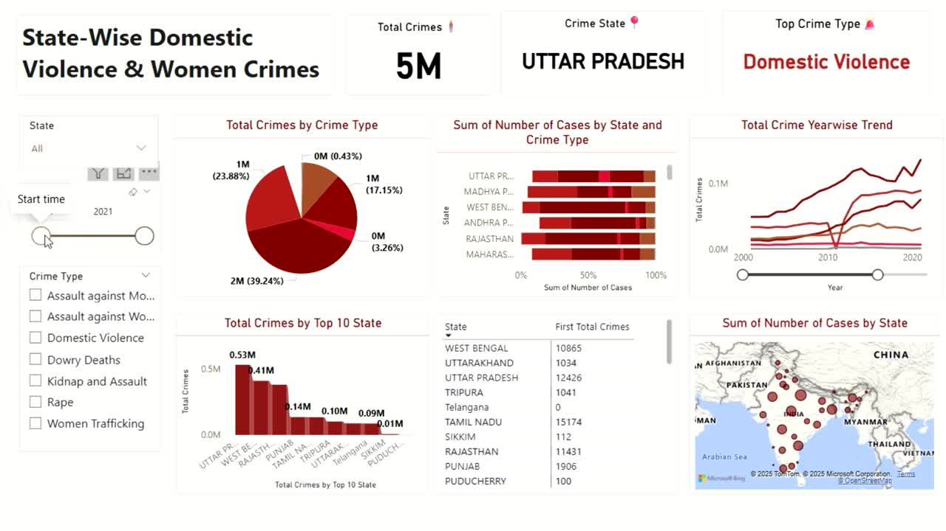

Slide 36

CONCLUSION :
DOMESTIC VIOLENCE IN INDIA IS NOT MERELY A WOMEN’S ISSUE BUT A PROFOUND PUBLIC HEALTH, HUMAN RIGHTS, AND NATIONAL DEVELOPMENT CHALLENGE THAT REQUIRES URGENT, COLLECTIVE ACTION. EFFECTIVE SOLUTIONS MUST BE INCLUSIVE, EMPATHETIC, AND MULTIDISCIPLINARY, COMBINING INNOVATIVE TECHNOLOGIES SUCH AS SOS APPS WITH GPS AND AI-BASED PREDICTIVE TOOLS, ALONGSIDE POLICY REFORMS AND COMMUNITY-DRIVEN INITIATIVES. BY UNITING YOUTH, GOVERNMENTS, AND LOCAL COMMUNITIES, WE CAN ENSURE EVERY HOME BECOMES A SAFE HAVEN, FREE FROM FEAR. THROUGH STRATEGIC INVESTMENTS, AWARENESS CAMPAIGNS, AND PARTNERSHIPS, WE CAN EMPOWER SURVIVORS, DISMANTLE HARMFUL NORMS, AND FOSTER A SAFER, MORE EQUITABLE SOCIETY FOR ALL.

Slide 37


